Slide 1


Quality Assessment of sequencing data

Slide 2
Outline
Why QC?
Bad data = bad assembly
Partial / missing data?
Is there enough data?
Did I get what I expect?
Can I assemble it?
Do I need to change my analysis workflow?
Is it the correct type?
Are there biases?
Is there contamination?
Most checks can be made before assembly and assembly validation
Focus:
Illumina data (PE + MP)
Pacbio data
Nanopore data

Slide 3
First steps
Make sure your data is whole.
File checksums ensure data integrity
MD5
$ md5sum file1.fastq.gz # before 823fc8b0ca72c6e9bd8c5dcb0a66ce9b file1.fastq.gz
$ md5sum -c checksums.md5 # after file1.fastq.gz: OK file2.fastq.gz: OK file3.fastq.gz: FAILED md5sum: WARNING: 1 of 3 computed checksums did NOT match
Calculate file checksums before transfer.
Validate checksums against the transferred files after the transfer.

Slide 4
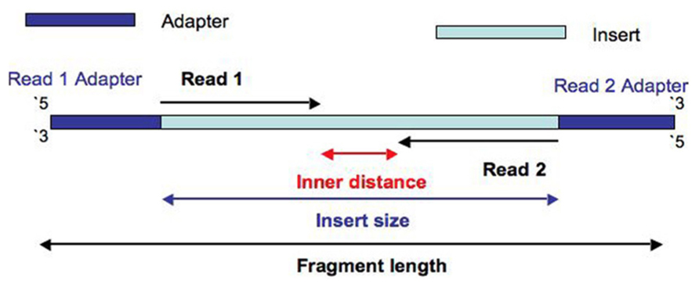
Illumina Sequencing
Paired end Illumina library

Slide 5
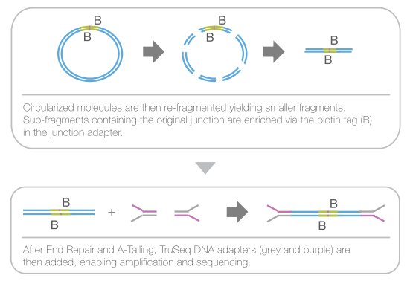
Illumina Sequencing
Mate pair Illumina library

Slide 6
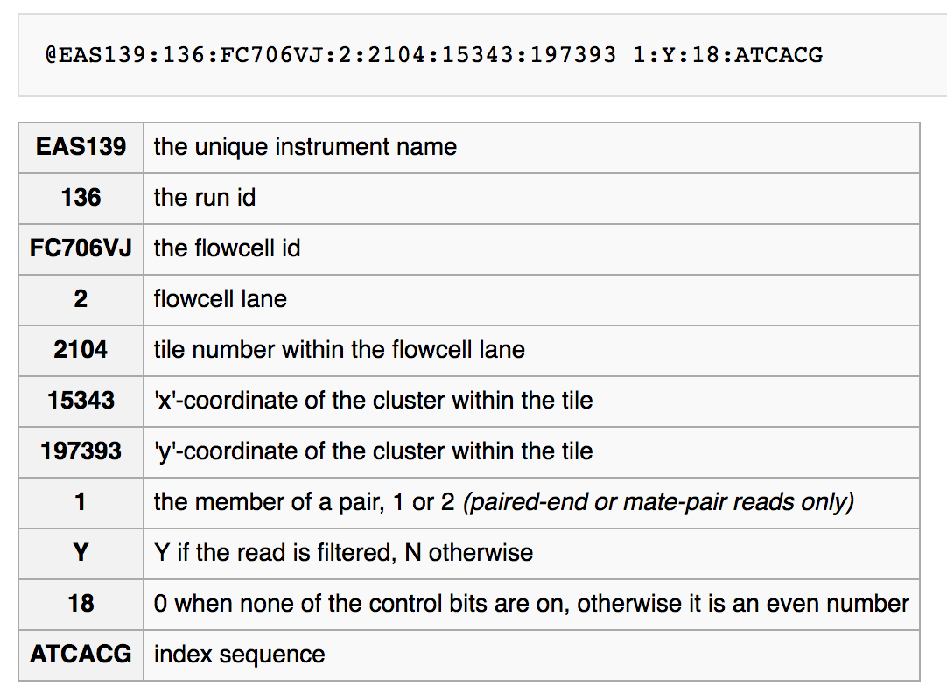
Format Check
Check the format
$ zcat file1.fastq.gz | head @HWI-ST486:212:D0C8BACXX:6:1101:2365:1998 1:N:0:ATTCCT CTTATCGGATCGATCCCAGTTTGGGCTTGTAAACGGTGAATCCTCAAAGACCACCAATGTTG + CCCFFFFFHHHHHJJJJJJHIJIIJGGJGFEGIGHIBFGHJIJIICHIIIDHGGIGIGHEFG @HWI-ST486:212:D0C8BACXX:6:1101:2365:1998 2:N:0:ATTCCT TAACCGAGCAAACAAAAGTTGGTTGTCACAAATTGTAATGACCTGATTAAACTTGATTTTTT + CCCFFFFFHHHHHJIIIJHIJJHIJJJJJJJJJJJIJJJIJJJJJIIIJJIJJJJGIJJJJH

Slide 7
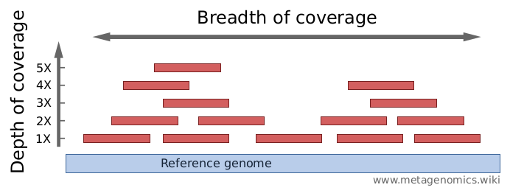
Do I have enough data?
What is my expected genome size?
What depth of coverage should I expect?
Illumina:
100x coverage in total
Coverage = Number of bases sequenced / Estimated genome size

Slide 8
Calculating data quantity
FastQC / MultiQC summary reports
Third party scripts
Command line calculation (my favourite way)
Can use Seqtk to convert files to fasta
zcat *.fastq.gz | seqtk seq -A - | grep -v “^>” | tr -dc “ACGTNacgtn” | wc -m
zcat ( concatenates the compressed fastq files into one stream )
seqtk ( converts to fasta format and drops reads less than 10k )
grep ( -v excludes lines starting with “>”, i.e. fasta headers )
tr ( -dc removes any characters not in set “ACGTNacgtn” )
wc ( -m counts characters )
parallel ‘seqtk seq -A {} | grep -v “^>” | tr -dc “ACGTNacgtn” | wc -m’ ::: *.fastq.gz | paste -sd+ | bc -l

Slide 9
Calculating data quantity
How much data is too much data?
Greater than 200X coverage is considered extreme.
Why is too much data bad?
Increased computation time and resources
Errors begin to compound and start to look like real data.
Assemblies become more fragmented and inaccurate.
How should I subsample?
Use a random fraction of the reads maintaining read pairing.
E.g. Use the same seed (-s) and give the fraction (0.1) in Seqtk. seqtk sample -s100 read1.fq 0.1 > sub1.fq seqtk sample -s100 read2.fq 0.1 > sub2.fq
Normalize uneven coverage (e.g. bbnorm)

Slide 10
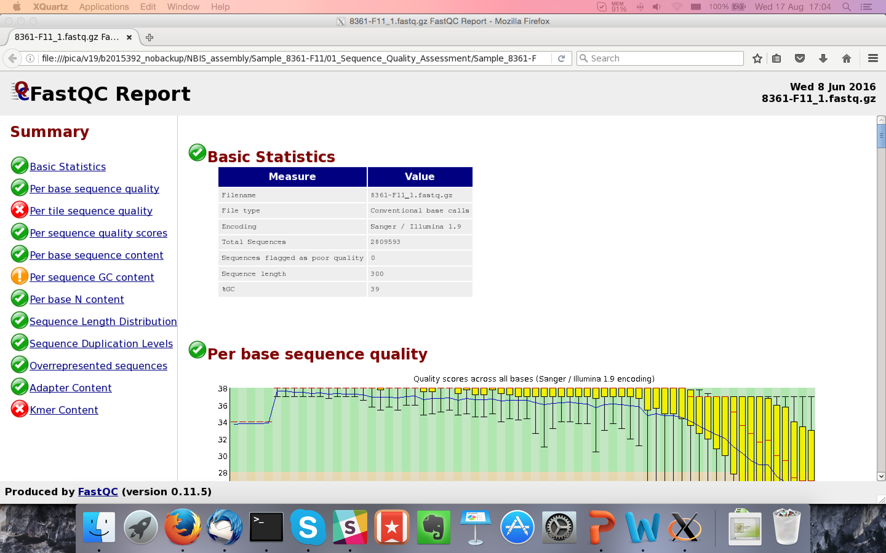
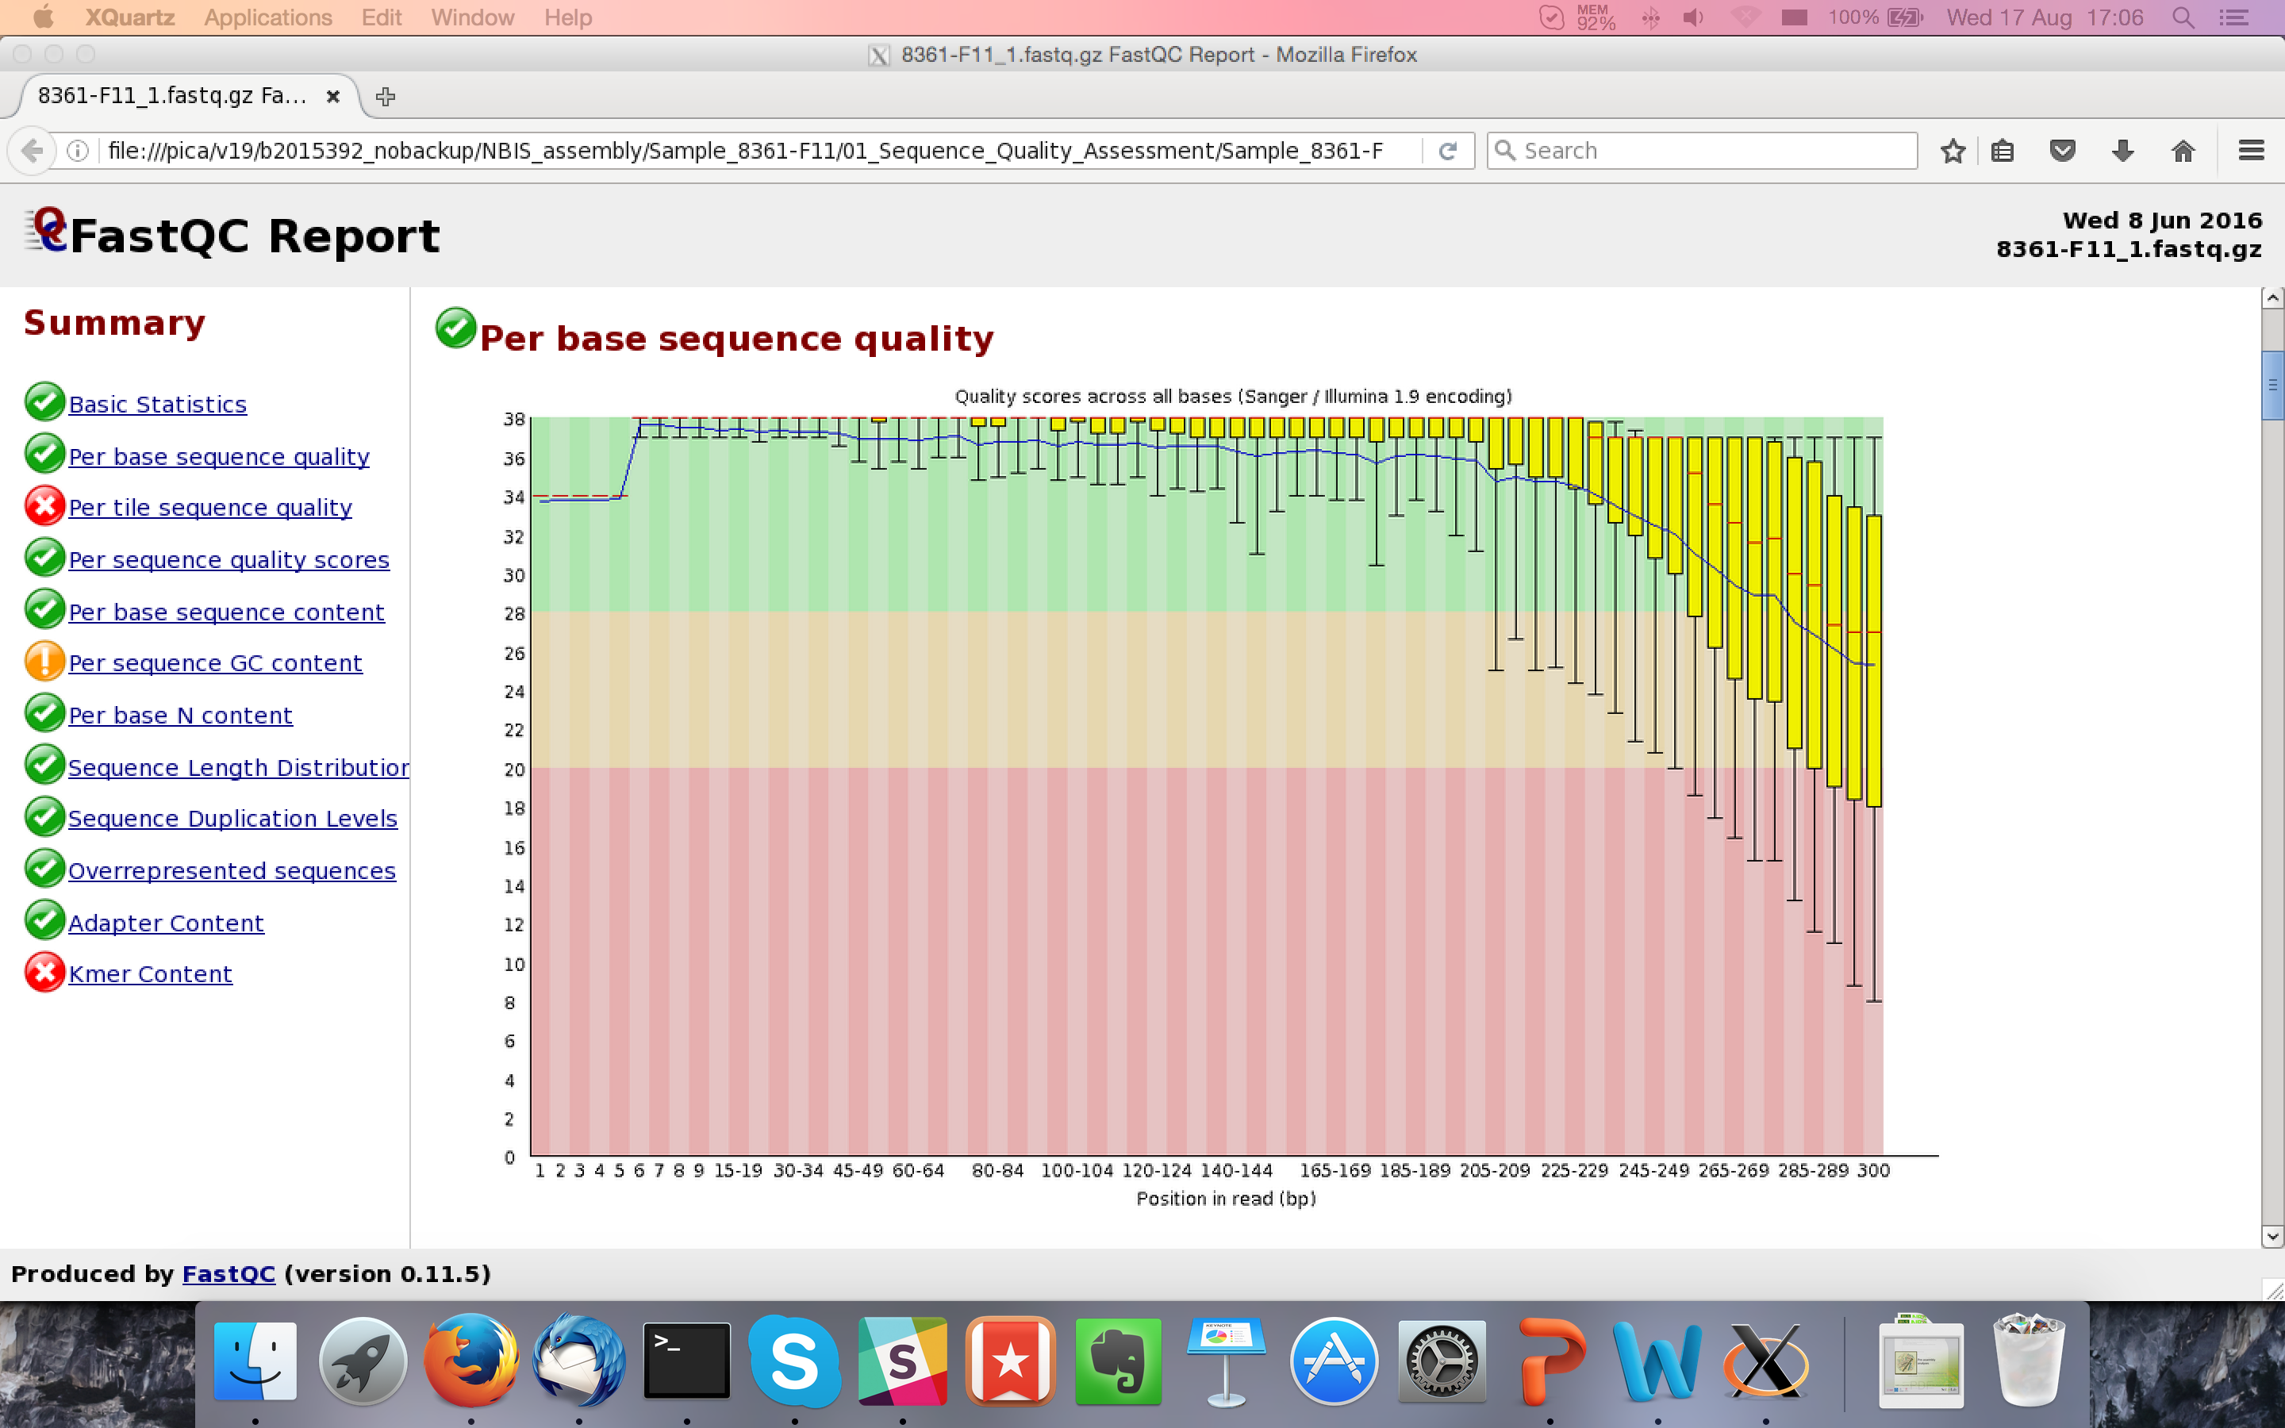
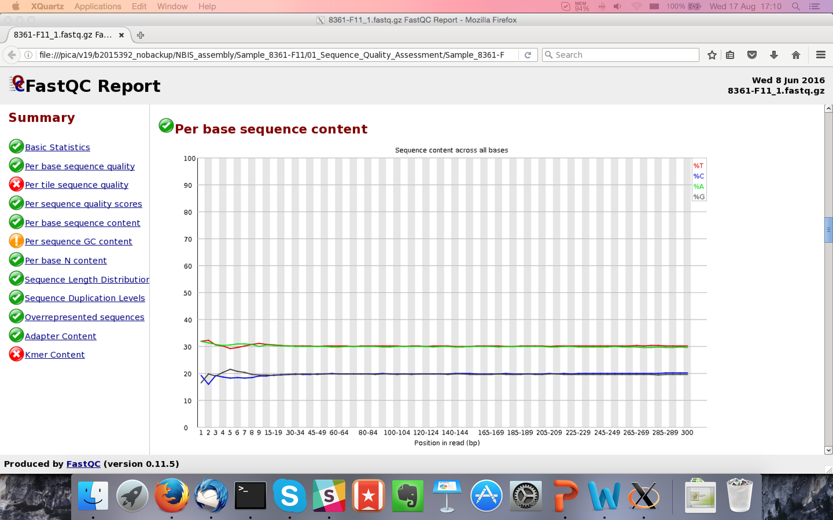
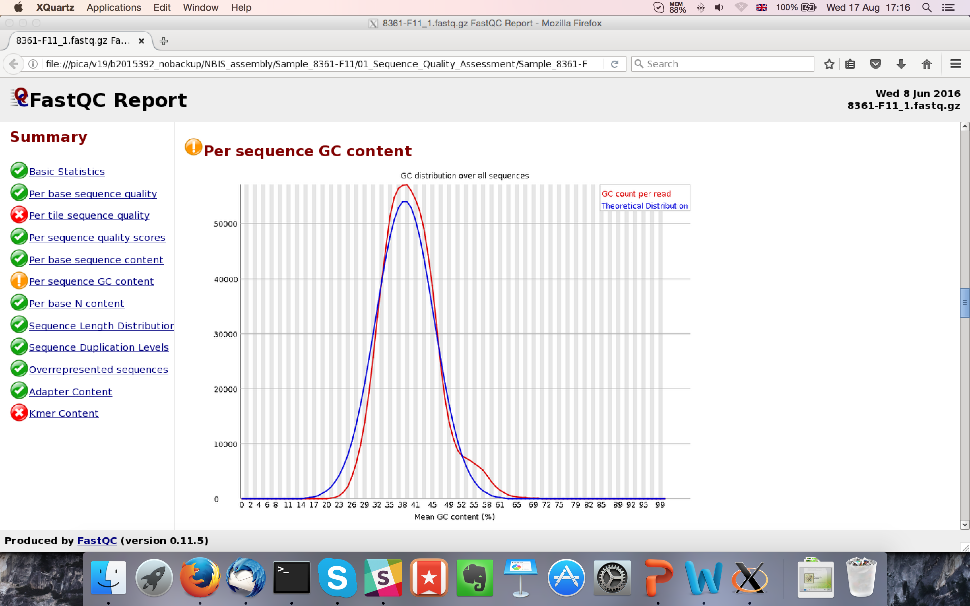
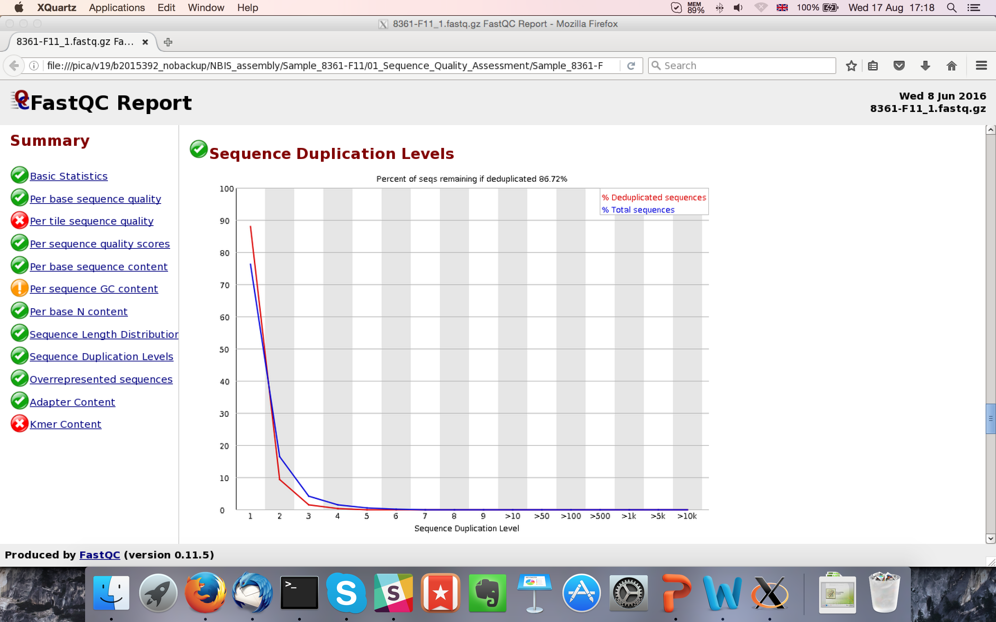
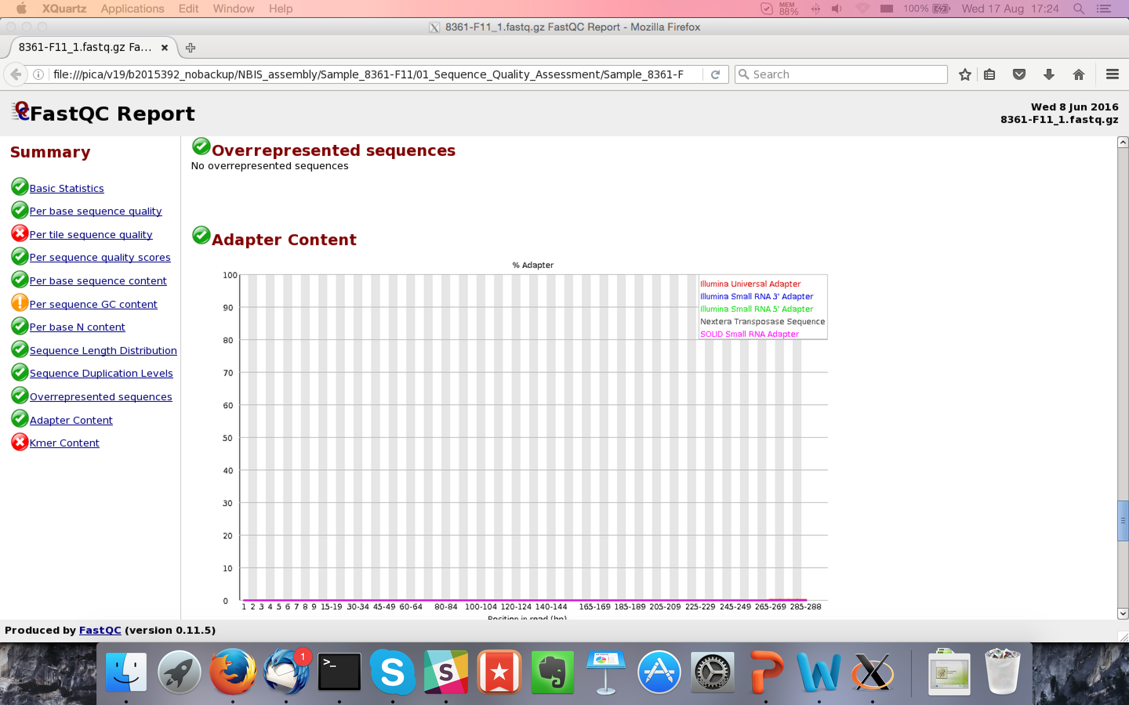
FastQC
What does it tell you?
Total read pairs
Sequence length
Quality Score Encoding
Average GC%
Base quality along the read
Nucleotide % along the read
Sequence GC content
Duplication %
Adapter content
Look at MultiQC for multiple samples

Slide 11
FastQC

Slide 12
FastQC

Slide 13
FastQC
Q(40) => Error probability = 0.0001
Blue line = mean quality
Good Quality
Q(30) => Error probability = 0.001
Reasonable Quality
Phred Quality Score
Q(20) => Error probability = 0.01
Normal: Quality tends to degrade
near end of read.
1st read pair file often has slightly
better scores than 2nd read pair file.
Poor Quality

Slide 14
FastQC

Slide 15
FastQC
Expected Result: First few bases are not quite uniform.
Caused by Illumina primers. Results in minor fragment
selection bias.
Note: Trimming bases hides the bias. It does not fix it.
Expected: Uniform distribution at half of AT%
Expected: Uniform distribution at half of GC%

Slide 16
FastQC

Slide 17
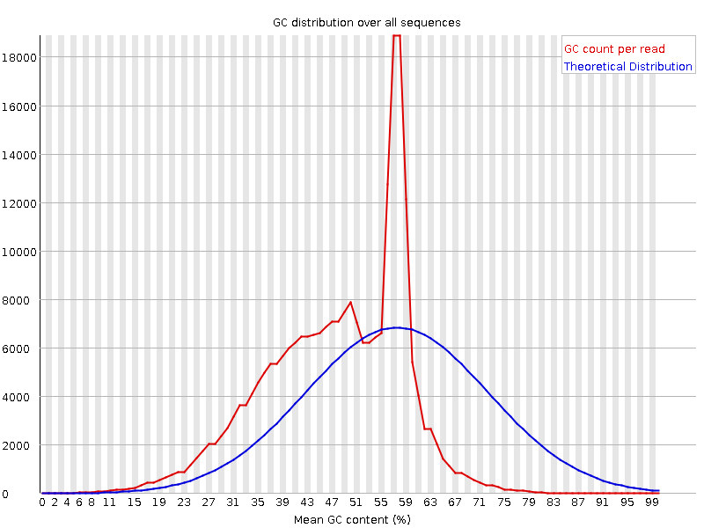
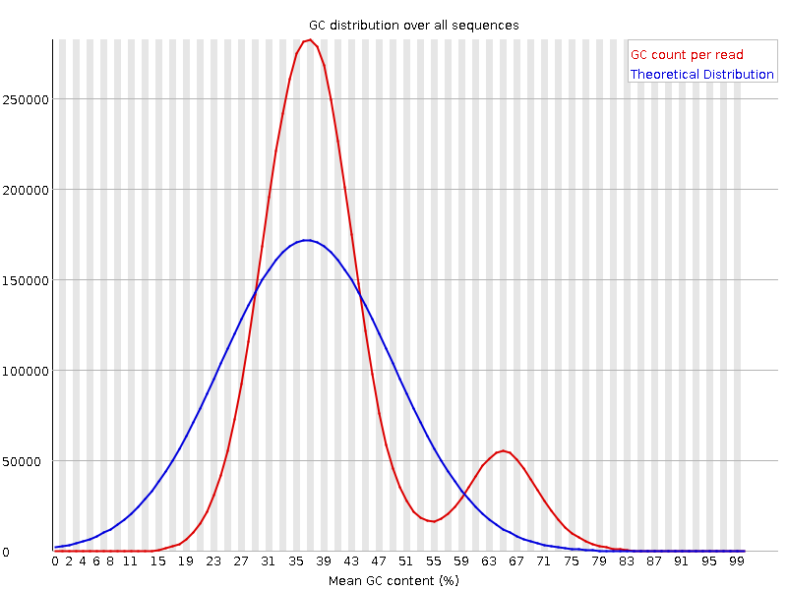
FastQC
This might be contamination or a feature of the genome
Sharp peak indicates
specific motif. Adapters are the usual suspect.
Wider or multiple distributions suggest contamination.
Expected: Normal/Gaussian Distribution

Slide 18
FastQC

Slide 19
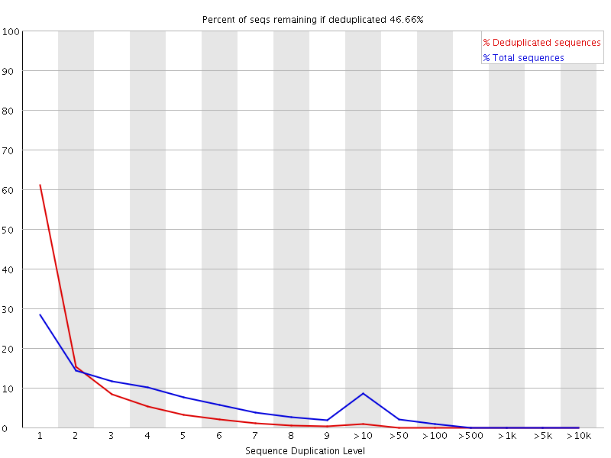
FastQC
First 100,000 sequences tracked until end of file
Exact sequence match
How much data is left after deduplication.
Sequences over 75bp are truncated to 50bp
Percentage of sequences with duplication y
Red trace should show sequences in library are diverse. Many low frequency sequences.
If peak persists in the red trace then there might be severe technical duplication or contamination
Peak shows 10%+ sequences with high duplication levels

Slide 20
FastQC

Slide 21
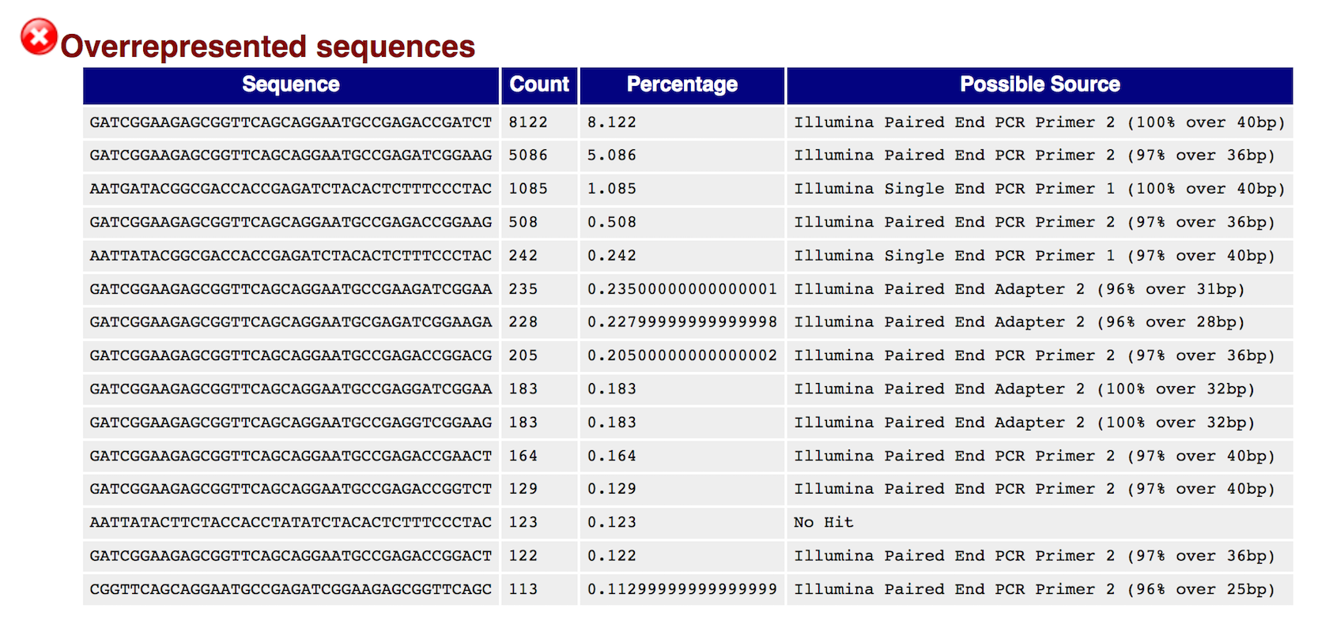
FastQC
First 100,000 sequences tracked until end of file
Lists sequence that is more than 0.1%
Overrepresented sequences are matched against known contaminants.
Match hits are not conclusive, but indicative.
Matches must be >20bp and only 1 mismatch.
Adapter content specifically checks k-mers for matches to known adapter sequence.

Slide 22
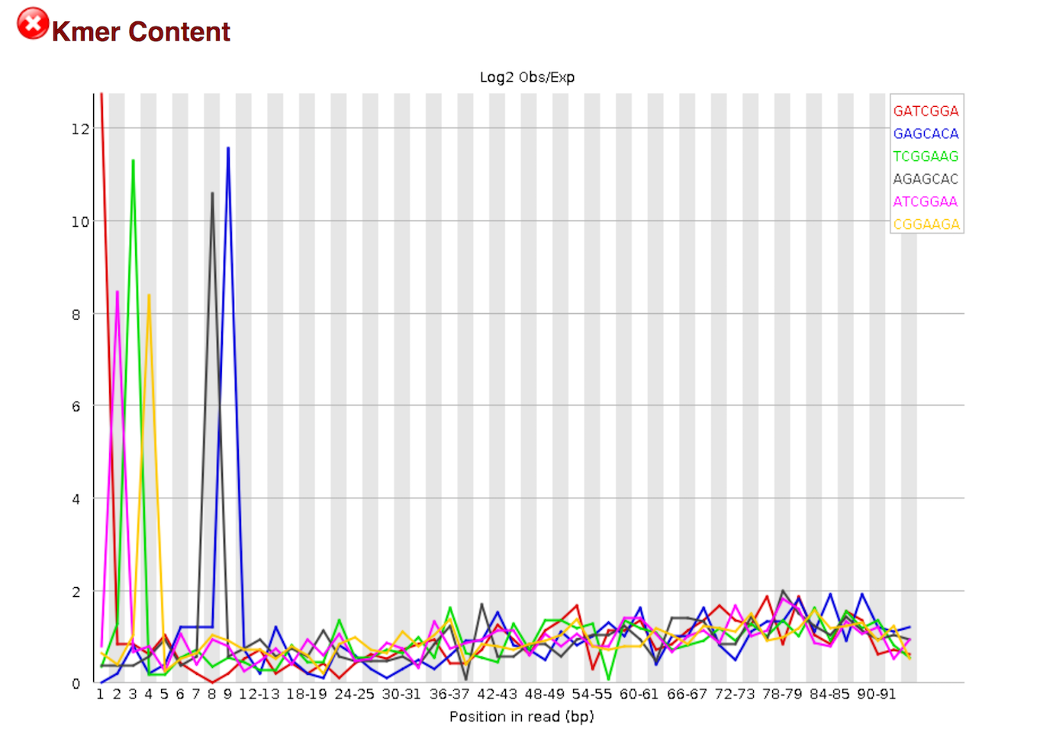
FastQC

Slide 23
FastQC
Is a k-mer over-represented along the length of a read? All k-mers should have equal probability of occurring at any position in the read.
K-mers are consistent with Illumina TruSeq adapter sequence.
Over-representation at the beginning of the read implies many adapters with no DNA fragment in between.
Default k is 7. K-mer size can be increased with option -k

Slide 24
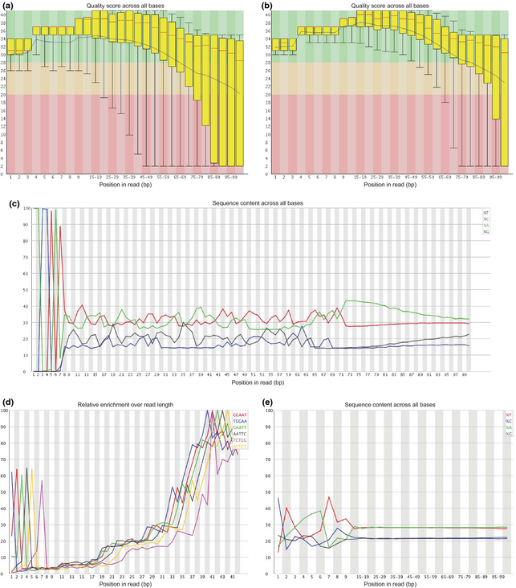
FastQC
Heavy adapter contamination consistent with short DNA fragments between adapters
K-mers consistent with adapter sequences and barcodes/indices

Slide 25
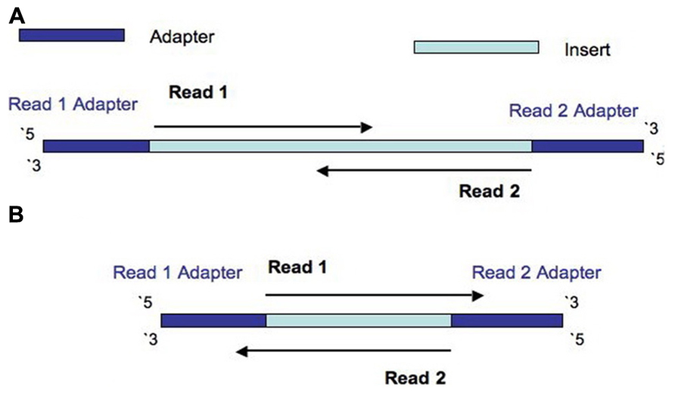
Trimming reads
Why trim reads?
Remove adapter read through.
Update to date list of Illumina adapters: https://support.illumina.com/downloads/illumina-customer-sequence-letter.html

Slide 26
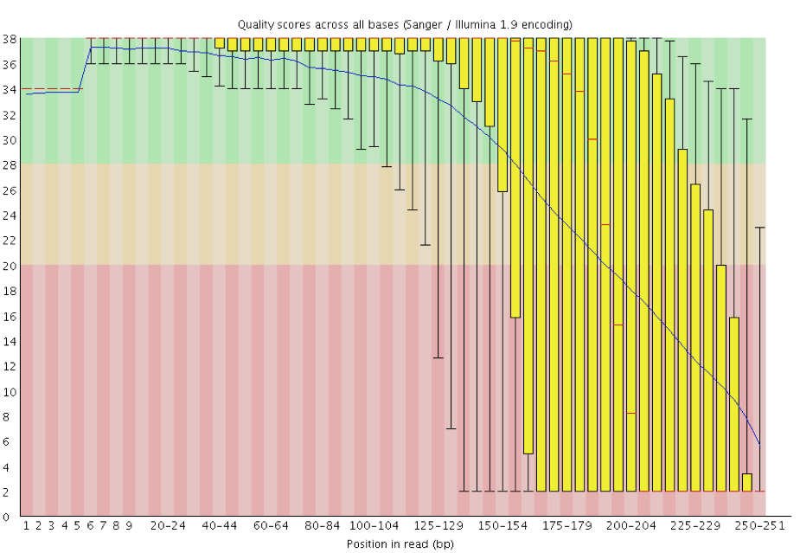
Trimming reads
Why trim reads?
Remove poor quality reads

Slide 27
Trimming reads
Many tools available
Trimmomatic
CutAdapt
AlienTrimmer
Sickle
Trim Galore
Scythe
Prinseq
…
Warning: Some assemblers expect untrimmed input
Allpaths-LG
Mira

Slide 28
Trimming reads
Library type
Quality Score encoding
Trimmomatic: java -jar trimmomatic-0.36.jar PE -phred33 input_forward.fq.gz input_reverse.fq.gz output_forward_paired.fq.gz output_forward_unpaired.fq.gz output_reverse_paired.fq.gz output_reverse_unpaired.fq.gz ILLUMINACLIP:TruSeq3-PE.fa:2:30:10 LEADING:3 TRAILING:3 SLIDINGWINDOW:4:15 MINLEN:36
BBMerge can be used to discover adapters: bbmerge.sh in=reads.fq outa=adapters.fa
Input file pair
Output
How to trim and
what to keep
Fasta file of sequences to remove (adapters, linkers, etc)

Slide 29
Duplication Removal
Why do duplicates arise?
Optical duplicates (amplified cluster mistaken for multiple clusters)
PCR duplicates
Why are duplicates bad?
Poor overlap information
Increased variance of coverage
Increased computation time and resources
How to remove duplicates:
Prinseq
FastUniq
ParDRe
…

Slide 30
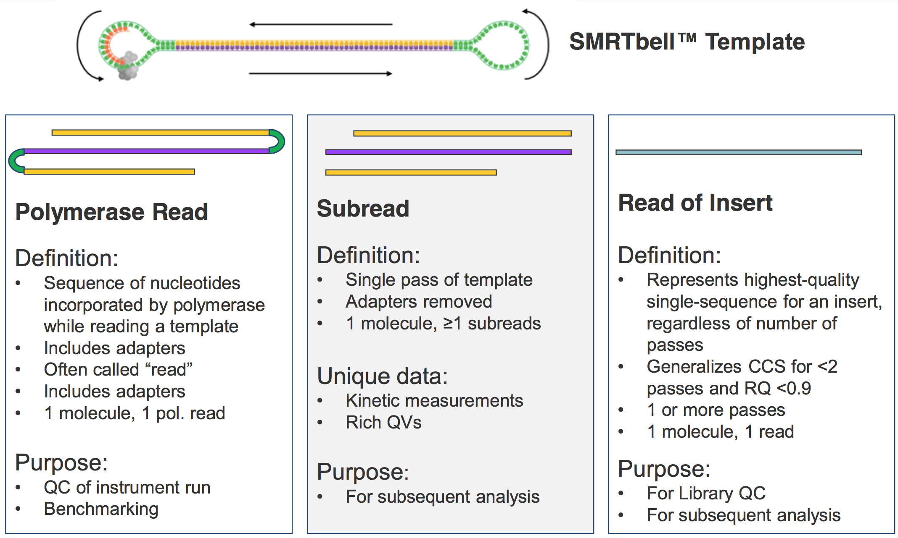
PacBio Sequencing

Slide 31
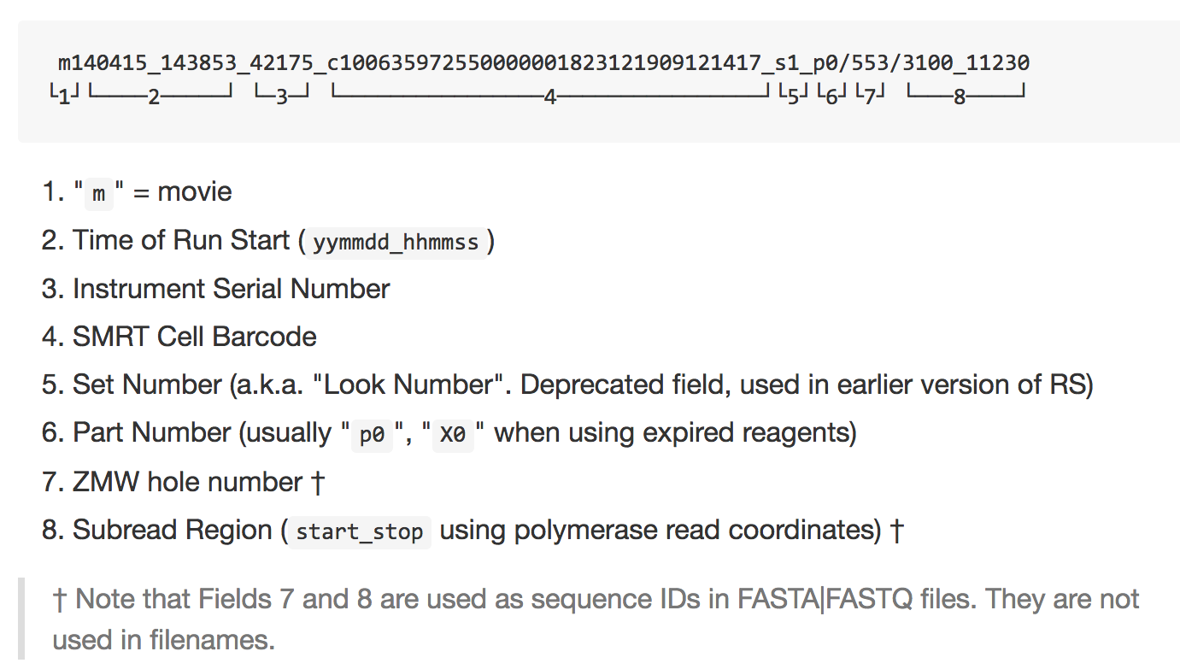
PacBio Sequencing

Slide 32
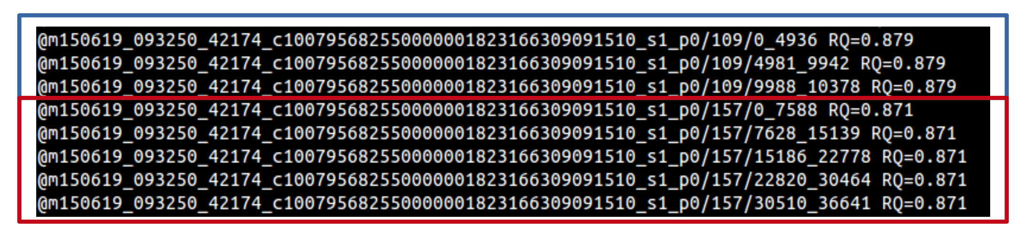
PacBio Sequencing
The subreads fastq file contains all the subreads from a SMRT movie.
The reads from a ZMW after adapter removal are oriented in the direction forward, reverse, forward, and so on.
Read Quality (RQ) Assignment: A trained prediction of a read’s mapped accuracy based on its pulse and base file characteristics (peak signal-to-noise ratio, average base QV, interpulse distance, and so on).
Quality Value (QV): The total probability that the basecall is an insertion or substitution or is preceded by a deletion. QV = -10 * log10(p).

Slide 33
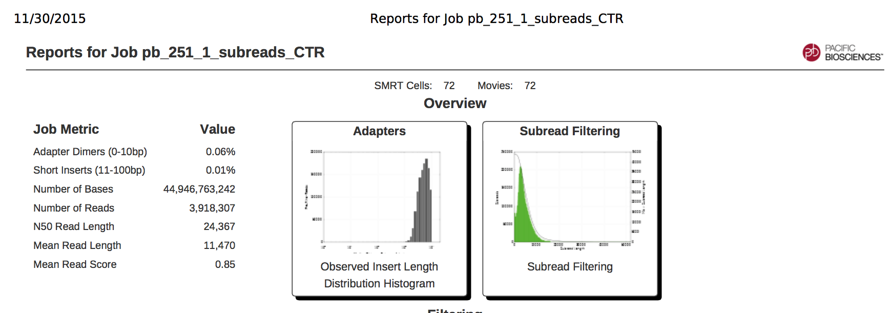
Do I have enough data?
What is my expected genome size?
What depth of coverage should I expect?
PacBio:
70x coverage in total from subreads per allele
At least 30x coverage of reads >10kb per allele
Coverage = Number of bases sequenced / estimated genome size

Slide 34
Calculating data quantity
Third party scripts
Command line calculation (my favourite way)
Can use Seqtk to convert and filter on read length
zcat *.fastq.gz | seqtk seq -A -L 10000 - | grep -v “^>” | tr -dc “ACGTNacgtn” | wc -m
zcat ( concatenates the compressed fastq files into one stream )
seqtk ( converts to fasta format and drops reads less than 10k )
grep ( -v excludes lines starting with “>”, i.e. fasta headers )
tr ( -dc removes any characters not in set “ACGTNacgtn” )
wc ( -m counts characters )
parallel ‘seqtk seq -A -L 10000 {} | grep -v “^>” | tr -dc “ACGTNacgtn” | wc -m’ ::: *.fastq.gz | paste -sd+ | bc -l

Slide 35
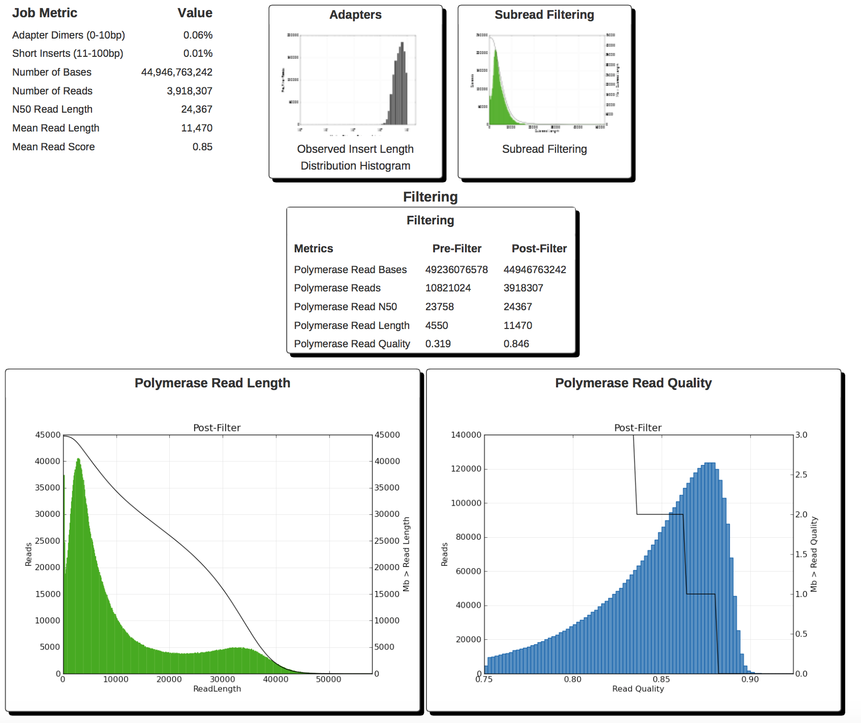
SMRT Portal Report

Slide 36
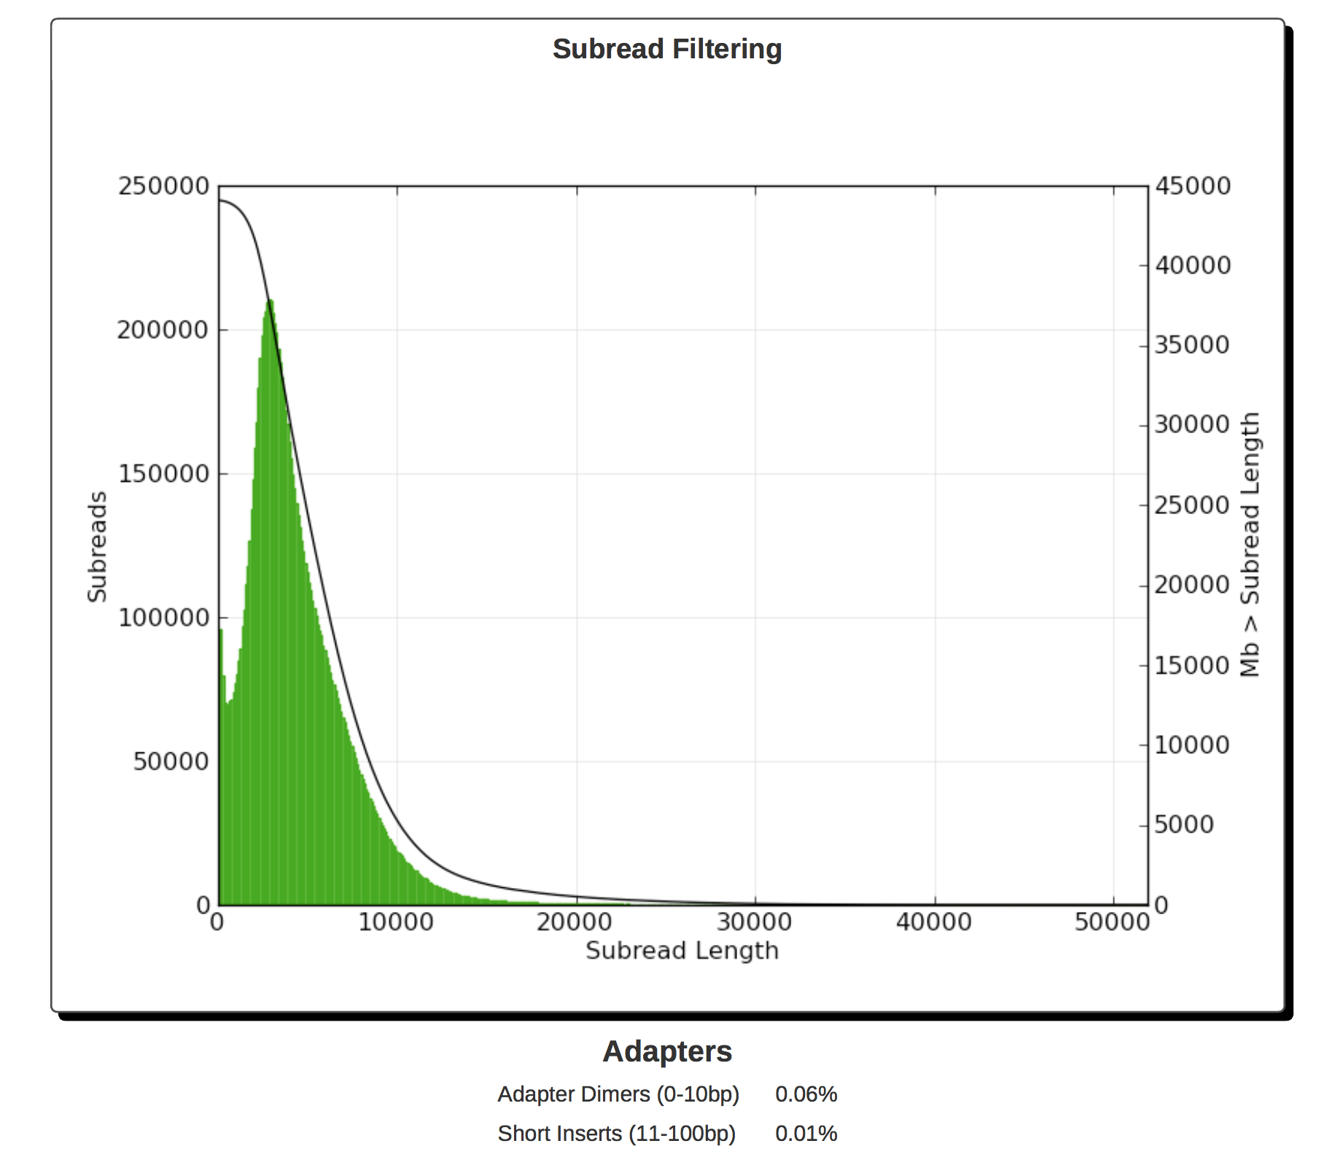
SMRT Portal Report

Slide 37
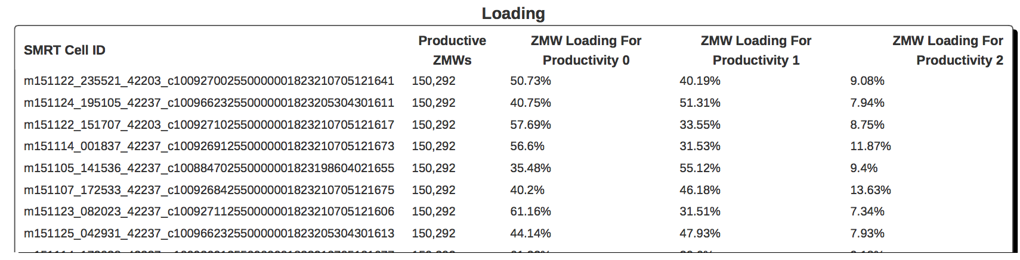
SMRT Portal Report
SMRT cell loading
P0: % of ZMWs that are empty with no polymerase
P1: % of ZMWs that are productive and sequencing
P2: % of ZMWs that are not P0 or P1 (e.g. unbound polymerase, more than one molecule in a well (overloaded cell)).
Maximize P1 and minimize P0 + P2.
High P0 indicates underloading (too low concentration of molecules)
High P2 indicates overloading (too high concentration) or poor prep.

Slide 38
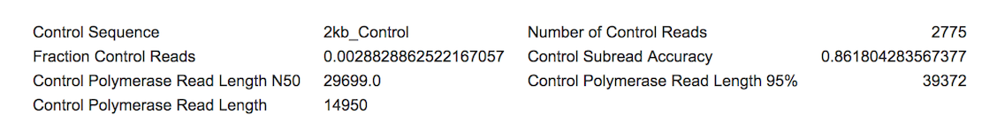
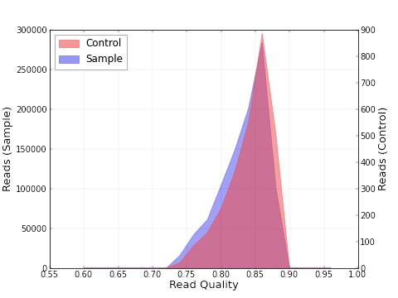
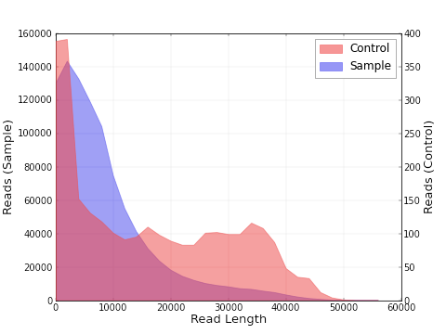
Control reads
SMRT portal does not filter out control reads unless the protocol is included.
Control reads are longer than Sample reads indicating good sequencing but bad Sample DNA quality

Slide 39
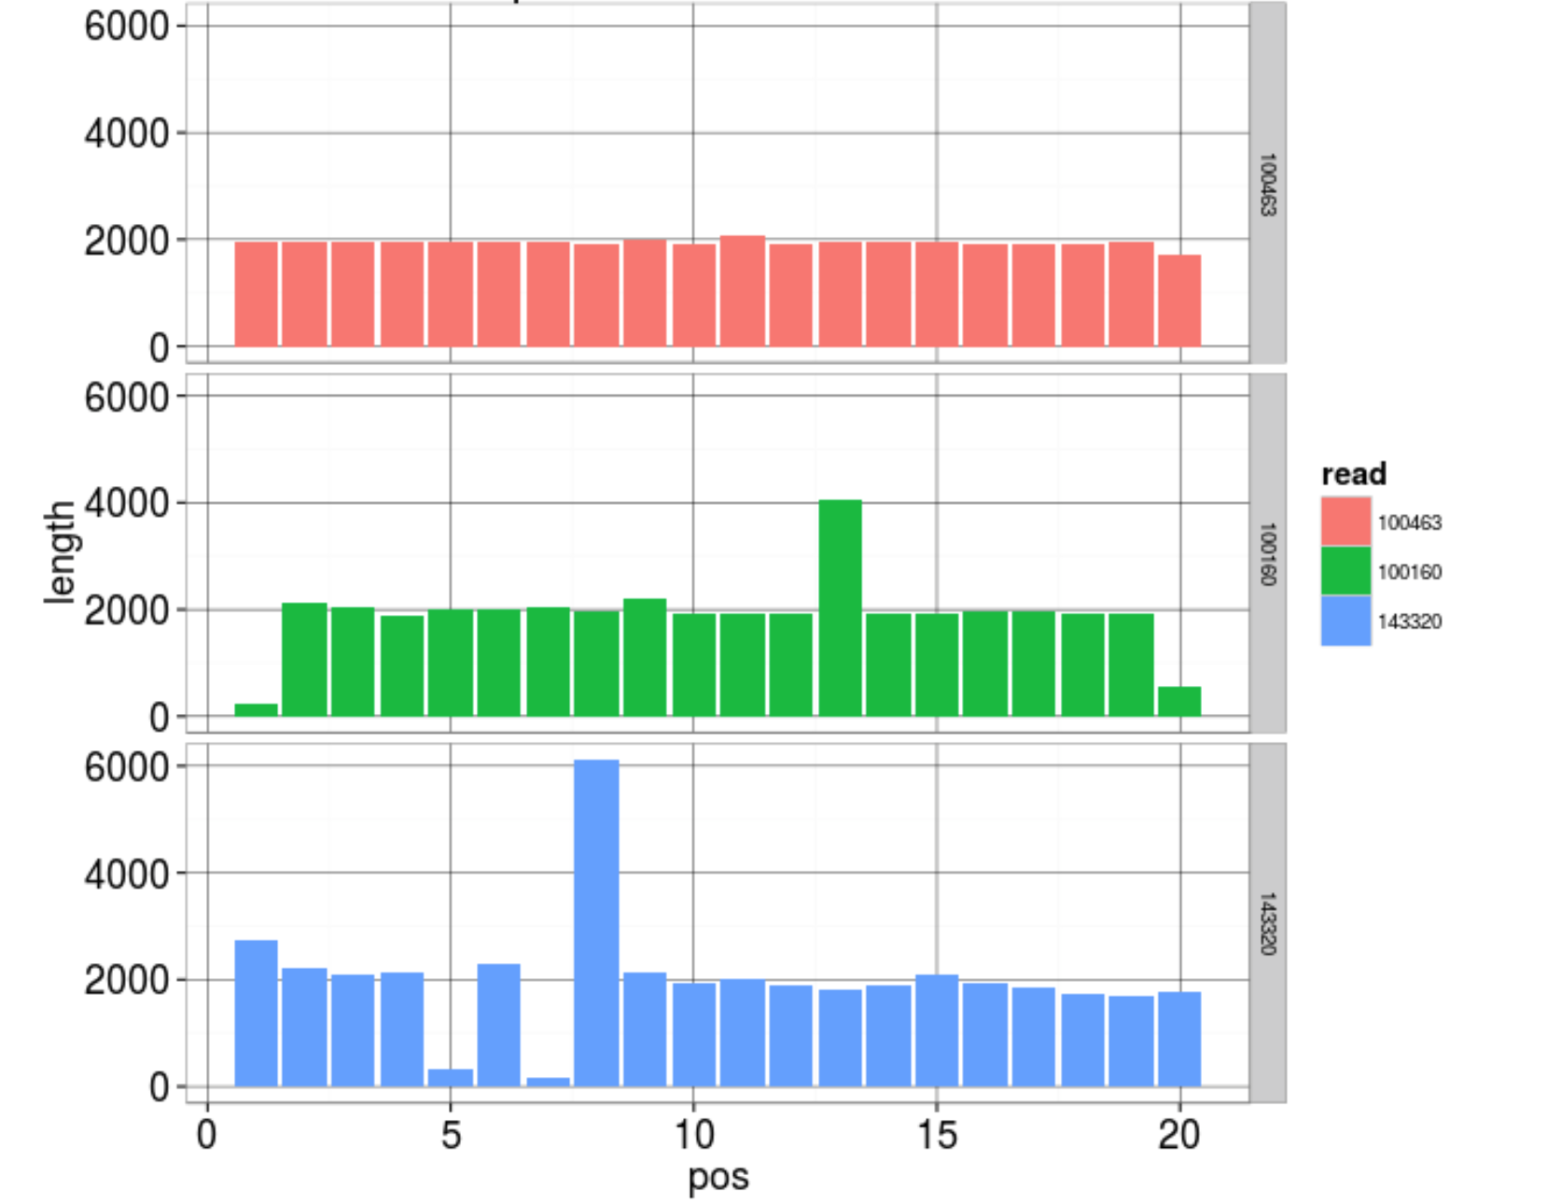
Adapter Trimming
SMRTbell adapter:
ATCTCTCTCTTTTCCTCCTCCTCCGTTGTTGTTGTTGAGAGAGAT

Slide 40
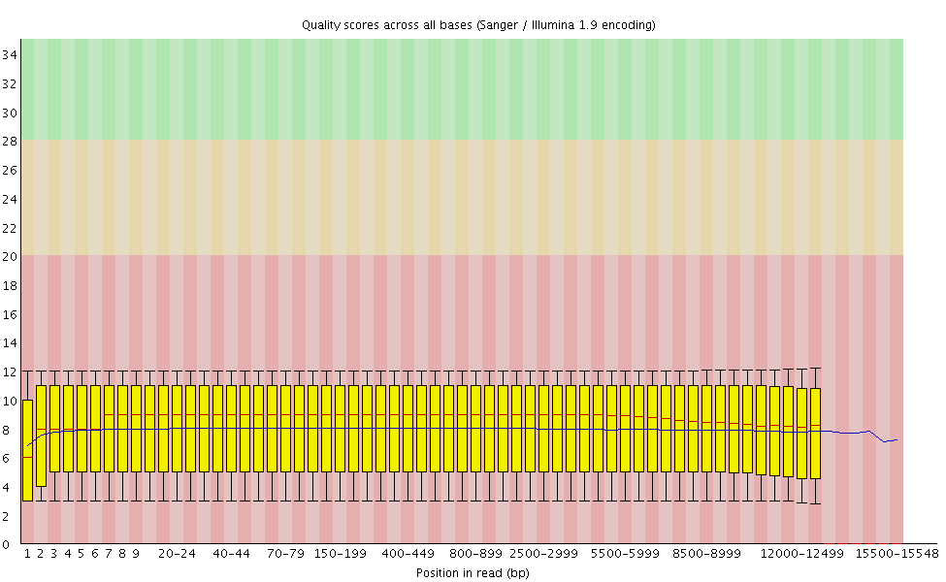
FastQC
Long read sequencing has a higher per base error rate (lower quality score).

Slide 41
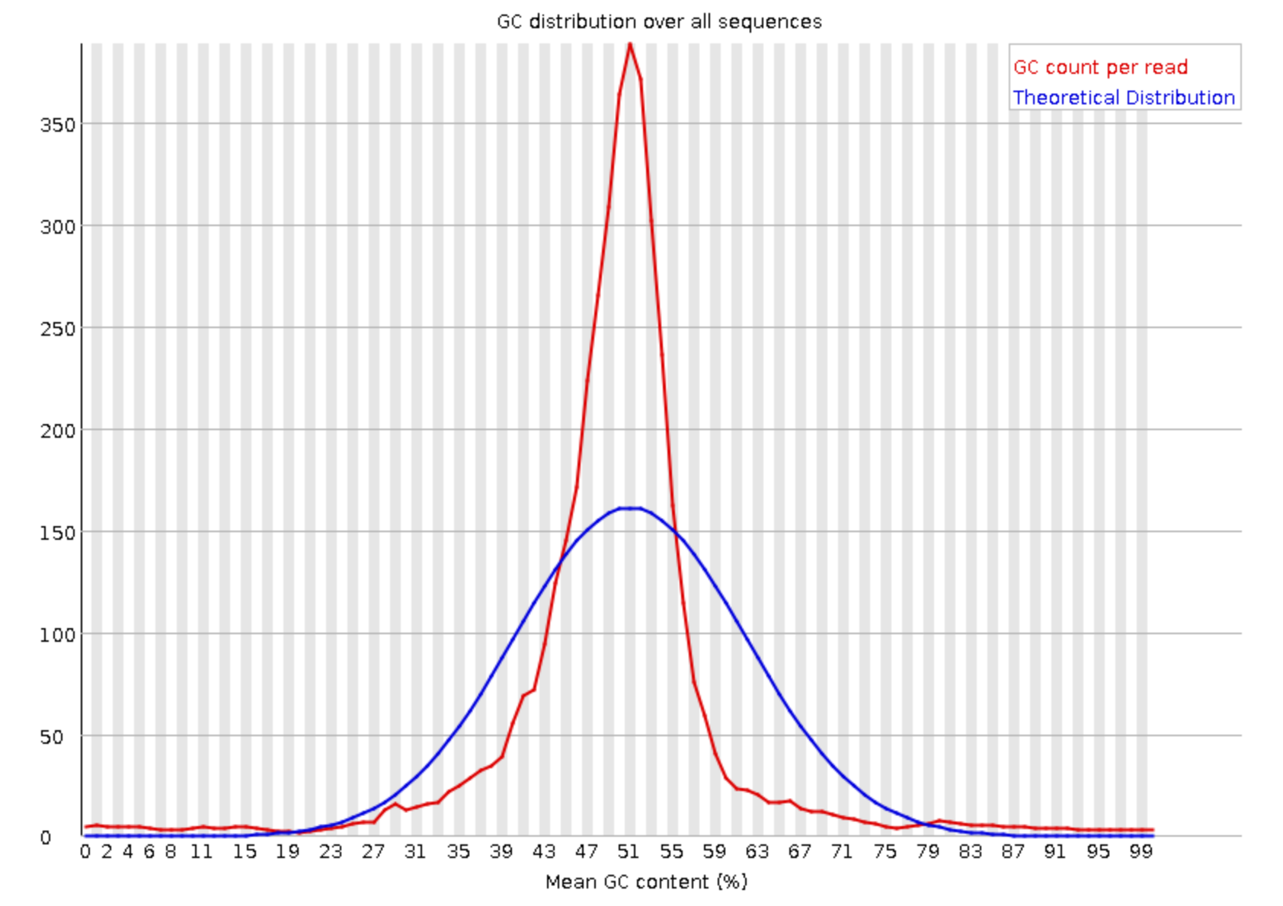
FastQC
Longer reads mean that average GC content per read tends more towards the average GC content of the genome (Sharper peak).

Slide 42
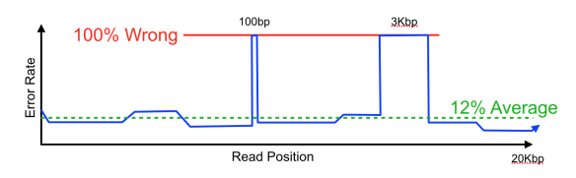
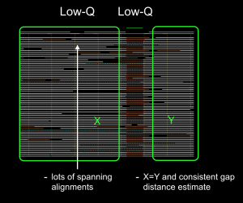
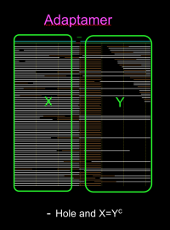
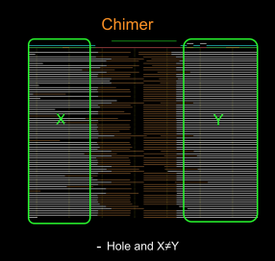
Read Errors
Quality score is inferred from the light signal.
Strong light signal does not imply correct base calls.

Slide 43
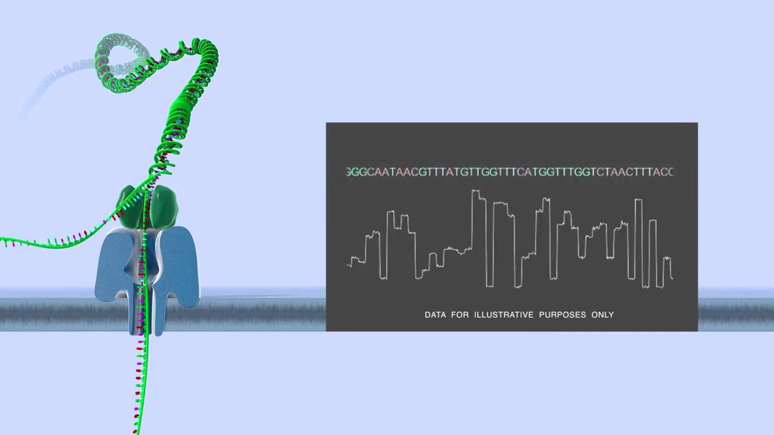
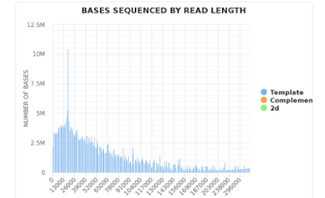
Nanopore sequencing
Single Molecule sequencing
No fragmentation required, therefore read length is theoretically unlimited. (Pacbio has size selected library)
Support is limited to the ONT community portal.
Limited QC tools.
Poretools (output summary)
Porechop (adapters)

Slide 44
Summary
Illumina
Md5sum
Format
Data Quantity
Quality Scores
GC Content
Nucleotide bias
Duplication
Adapter content
Fragment distribution
PacBio / Nanopore
Md5sum
Format
Data Quantity
GC Content
Adapter & Control check
Subread distribution

Slide 45
Information on sequence QC issues
Sequencing Fail https://sequencing.qcfail.com
SEQanswers http://seqanswers.com
BioStar https://www.biostars.org
Bioinformatics StackExchange https://bioinformatics.stackexchange.com

